Slide 2

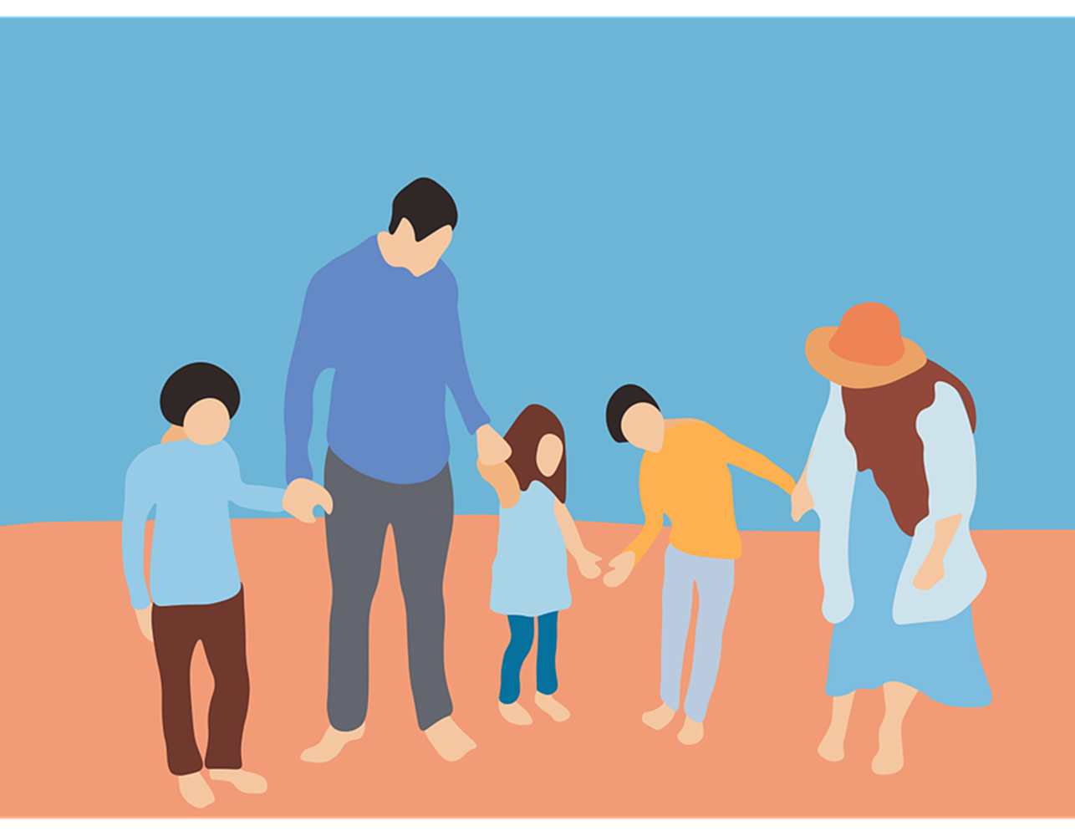
The Blessings & Responsibilities of God’s Family

Slide 3
Blessings of Physical Families
Love and care
Necessities of life
Protection
A good name

Slide 4
Responsibilities of Physical Families
Obedience
Provision
Respect
Training & admonition

Slide 5
A Christian is in God’s Family
Romans 8:16-17

Slide 6
The Blessings of God’s Family

Slide 7
God is our Father
1 John 3:1-2

Slide 8
We Wear the Greatest Name
Acts 4:12
Acts 11:26

Slide 9
We Enjoy the Protection of God
Matt. 10:28

Slide 10
We Receive Proper Spiritual Provisions
John 6:51

Slide 11
We Receive the Promises of God
2 Peter 1:3-4
Titus 1:1-2

Slide 12
The Responsibilities of God’s Family

Slide 13
Respect the Authority of God
Exodus 20:3-4
Matt. 4:10
Matt. 28:18
Col. 3:17

Slide 14
Defending the Cause of God
Phil. 1:17
Eph. 6:10-17
Romans 1:16
2 Cor. 10:1-6

Slide 15
Learning the Will of God
2 Timothy 2:15
Colossians 3:16
1 Peter 2:1-2
Matthew 5:6

Slide 16
Obeying the Commands of God
1 John 5:1-3
John 14:15
James 2:18

Slide 17
The Blessings & Responsibilities of God’s Family

