Slide 1
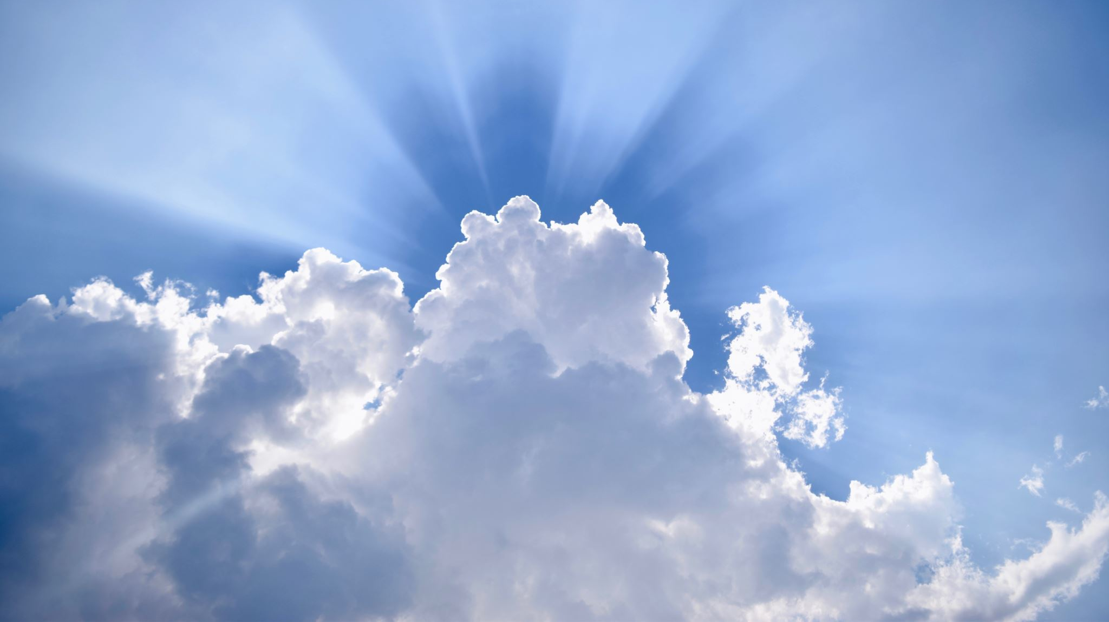
Heaven: The Home of Our Soul

Slide 2
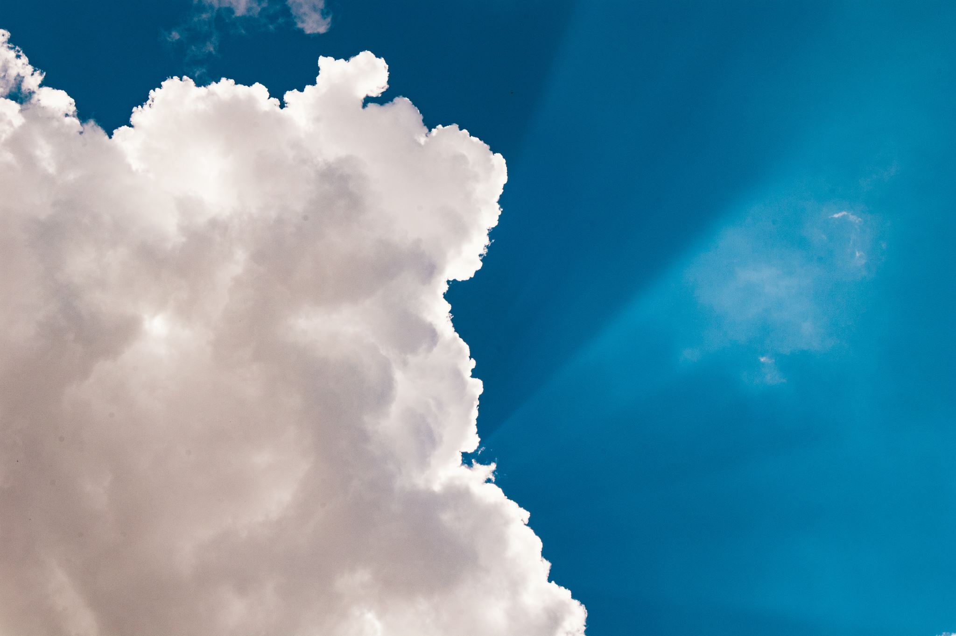
We Are Looking for a City

Slide 3
Abraham Looked for a City: Heb. 11:8-16
Obeyed God but never inherited promised land.
Tents = nomadic life of God’s people of all ages.
Saw the better country from afar.

Slide 4
We Too Are Looking for a City: Heb. 13:4
Jesus is preparing a place. John 14:1-3
A City for us. Hebrews 11:16
As a bride prepared for her husband. Revelation 21:2

Slide 5
John’s Vision of that Heavenly City
Revelation 21:1-22:5

Slide 6
The Figures of the Bride and the City
Bride suggests relationship b/w church and the lamb.
Bride is object of His love.
She is holy & w/out blemish.
Eph. 5:23-27; Rev. 19:7

Slide 7
John’s Heavenly Vision: Rev. 21:1-22:5
Symbolic language is meant to give our finite minds a sense of the infinite…
Earthly figures provide only the merest glimpse of the actual glories of Heaven

Slide 8
The City’s Beauty: Incomparable
Reflects the Glory of God.
Focus is on the unparalleled beauty of this city built by God for those who love Him.

Slide 9
Size & Structure: Incredible
1,500 x 1,500 x 1,500 mi.³
2.25 M. mi.² (Australia)
12 foundation stones each 500 mi. long
Symbolize that God’s city is without comparison.

Slide 10
Life in the City: All Inclusive Happiness
Today “big cities” = crime, violence, etc.
People don’t feel safe; lock doors.
In Heaven no fear or suffering. Rev. 21:8, 4

Slide 11
Life in the City: All Inclusive Happiness
Water of life.
Tree of life.
In these symbols we see images of the truth that God will take care of everything we need…

Slide 12
Life in the City: Inconceivable Privileges
Presence of God
Inherit blessings
God / Lamb is the Light
His name upon us.
Reign w/ Him forever

Slide 13
“So, whatever burden must be borne now, whatever sacrifice must be made, whatever condition must be met, yea, whatever price must be paid, let us gladly meet the challenge….”
(Wendell Winkler)

Slide 14
“…For, throughout those ceaseless ages encased in the walls of jasper as we walk the street of gold, we will be heard to say, as did the queen of Sheba, ‘The half has never yet been told…’”
(Wendell Winkler)

Slide 15
Heaven: The Home of Our Soul

Slide 16
Noah Never Saw a Flood
Believed God.
Built and ark.
Delivered from an evil world.

Slide 17
Abraham never saw Heaven
But he longed for a better country…

Slide 18
You haven’t seen…
Streets of gold…
Pearly gates…
River of life…
Tree of life…
God’s face…

Slide 19
But when you die, do you expect to live in the beautiful, heavenly city, where God’s people enjoy infinite happiness and inconceivable privileges?

Slide 20
“Heaven is a prepared place for those who have prepared for it…”
(H. A. Dixon)

