Slide 1
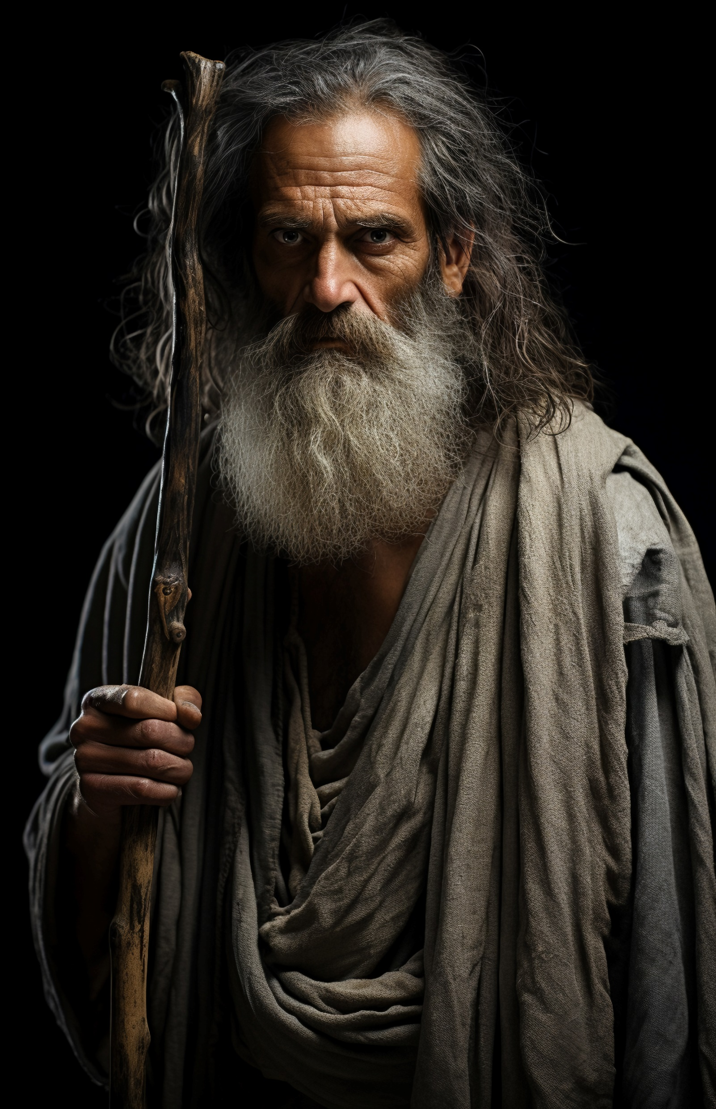
ELIJAH: BOLDLY FACING SIN
1 Kings 17-19

Slide 2
ELIJAH BOLDLY FACED KING AHAB.
Ahab’s Wickedness. 1 Kgs 16:25-33; 17:1
Elijah boldly preached. 1 Kgs 17:2-18:1; 18:17-18; 19:1-3
Others who followed his example. Mat 14:3-4, 10; Acts 7:51-53; 2 Cor 11:23-28; Rev 1:9
Christians must follow Elijah’s example. Mark 16:15-16; Rom 3:23; 6:23; 1:7, 15.

Slide 3
ELIJAH BOLDLY DEFEATED THE PROPHETS OF BAAL.
A bold warrior for God. 1 Kgs 18:17-40
Others who were bold.
Joshua. Joshua 24:15, 31
Paul. Acts 13:6-11
Christians must follow Elijah’s example. John 18:36-37; Eph 6:10-17;2 Cor 10:3-4

Slide 4
ELIJAH BOLDLY PREACHED DESPITE PERSONAL PERIL.
He fled twice. 1 Kgs 17:2-24; 19:1-21
Others were persecuted / killed.
Apostles and Prophets. Heb 11:32-40; 1 Ths 2:14-15
Stephen. Acts 7:51-53
Jerusalem Christians. Acts 8:1-4

Slide 5
WE MUST BE BOLD IN FACING SIN.
We will face persecution. 1 Tim 3:12
God will be with us! Mat 10:28; 1 Cor 10:13; Rom 8:28
We are called to proclaim God’s Word. Mark 16:15
We are not of the world. 1 Pet 2:9; Rom 12:1-2; 1 Cor 15:58.; Jam 4:4

Slide 6
ELIJAH: BOLDLY FACING SIN
1 Kings 17-19

